Slide 1
Pollution Monitoring System
Team Members
Shrey Jain
Riya Lotlikar
Snehal Ahire

Slide 2
Contents
Introduction
Motivation
Target Problem
Solution
Design
Implementation
Test Cases
Difficulties
Demonstration

Slide 3
Introduction
The growing pollution at such an alarming rate has started creating trouble for the living beings
High decibels or toxic gases present in the environment leaves a harmful effect on human’s health and thus needs a special attention
The rapid growth in infrastructure and industrial plants creating environmental issues like climate change, malfunctioning and pollution has greatly influenced for the need of an efficient, cheap, operationally adaptable and smart monitoring systems
To overcome this issue, a system through which the level of sound, the pollutants in the water and the existence of the harmful gases in the surroundings can be detected

Slide 4
Motivation
World is facing serious pollution problems, Pollution grabs attention only when it exceeds it’s limit
No Precautions are taken in order to keep track of pollution
A solution for monitoring the noise, water and air pollution levels in industrial environment or particular area of interest using wireless embedded computing system is proposed
Why Arduino? Compatibility with most of the sensors used

Slide 5
Target Problem
None of the implemented systems have ever done monitoring of Noise, Air and Water pollution together
Every model was specific to certain environment but we have proposed a system that can be used to monitor the surrounding pollution in different environments
Applications : This model is adaptable and distributive for any infrastructural environment that needs continuous monitoring, controlling and behavior analysis
It will provide data in organized way to public and help spread awareness in this fight with pollutions

Slide 6
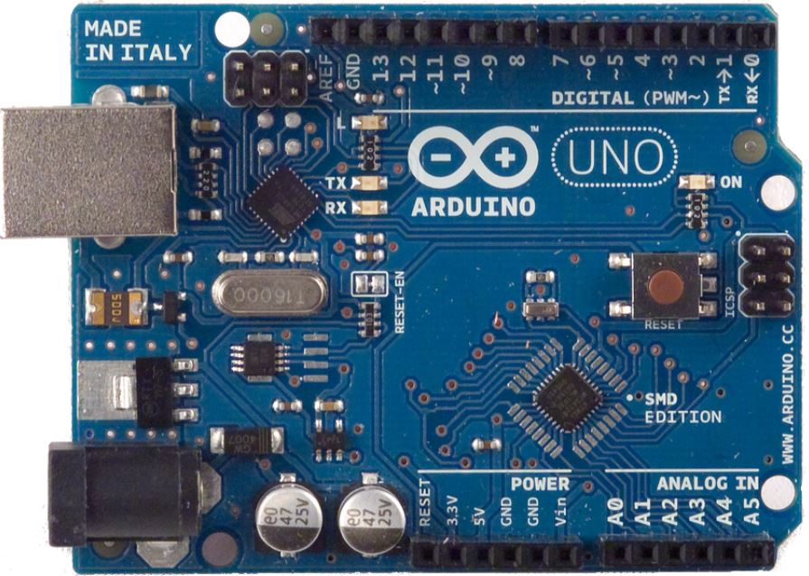
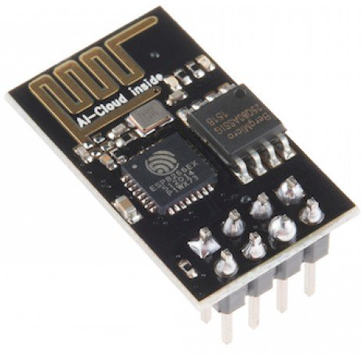




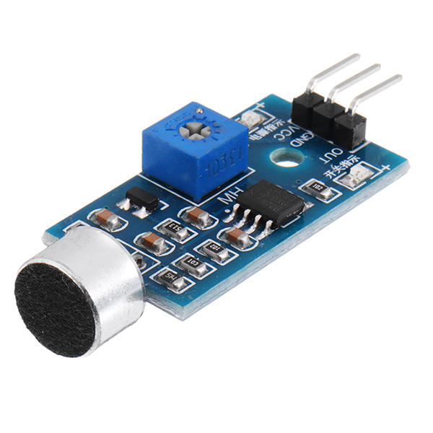
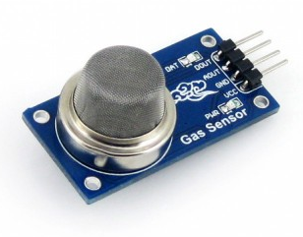


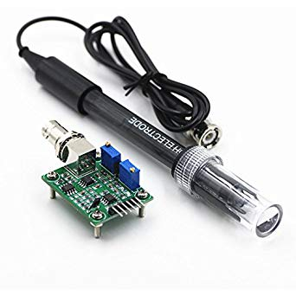

Slide 7
Design
Architectural
ER Diagram
Circuit

Slide 8
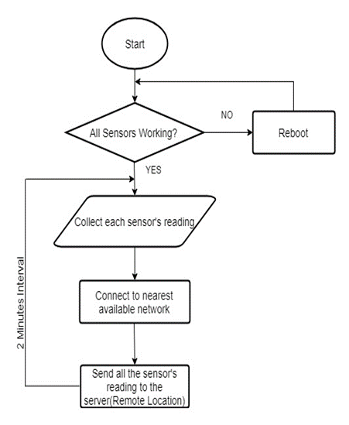
Architectural Design

Slide 9
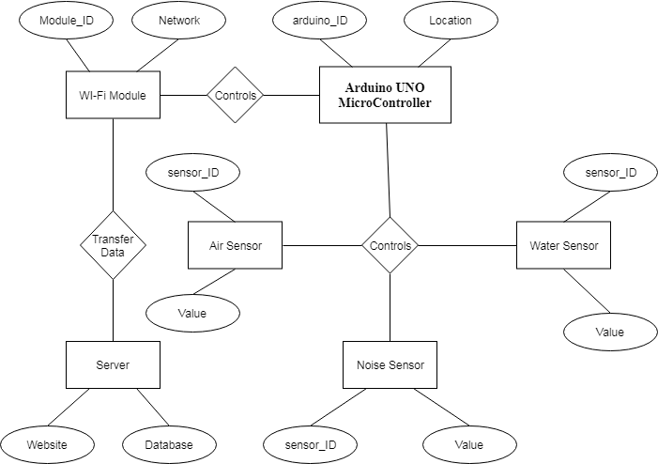
ER Diagram

Slide 10
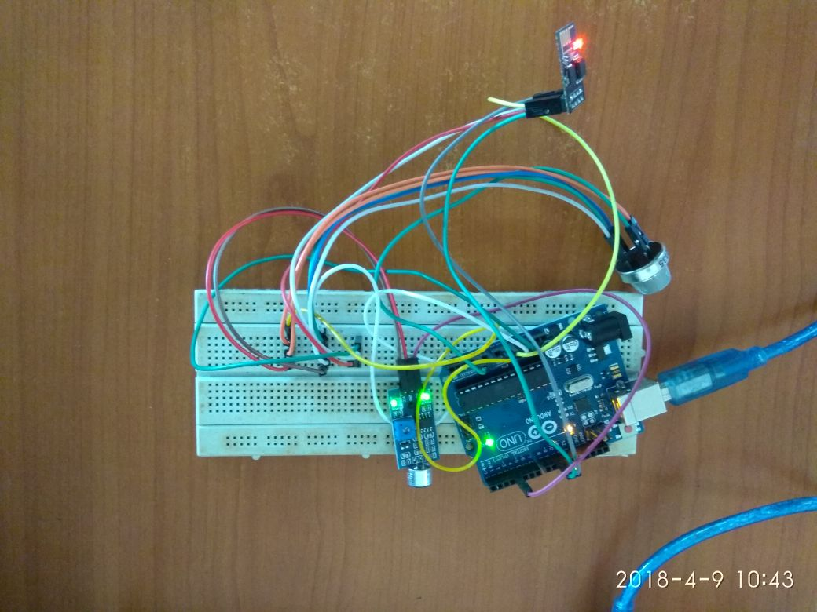
Circuit Design

Slide 11
Implementation
The main aim is to develop a kit which will be installed in the required location for monitoring
The kit will basically include Arduino, on which all the sensors will configured and Wi-Fi module for data transfer
Collect the respective pollution readings after certain time interval
Readings from all the kits will be recorded and saved into the database at the server end

Slide 12
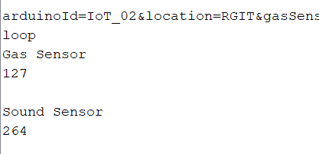
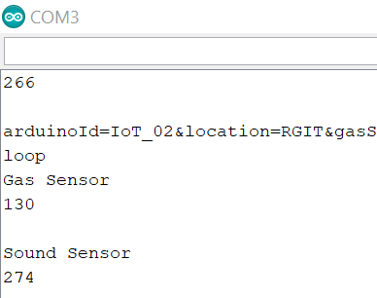
Test Case 1 Sound Sensor
Normal Taps near the sensor generated fluctuation in values
Sound Sensor before tapping : 264
Sound Sensor after tapping : 274

Slide 13
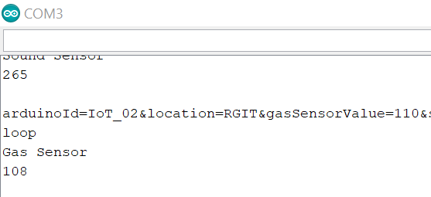
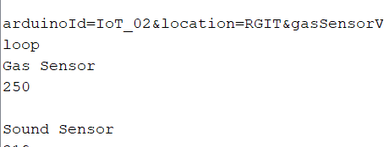
Test Case 2 Gas Sensor
Gas Sensor senses Smokes, Alcohol
Tested the sensor with burned paper smoke
The values drastically changed from
108 to 250

Slide 14
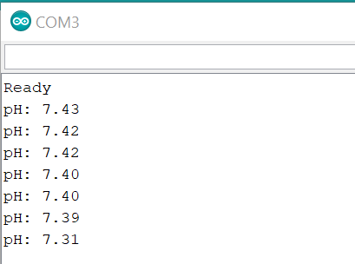

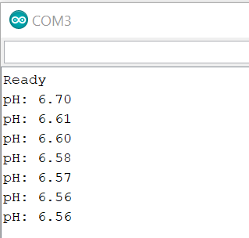

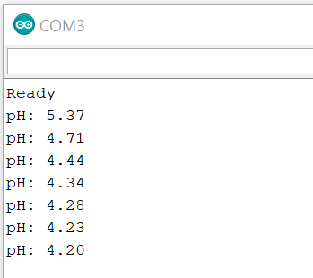

Test Case 3 pH Sensor
The pH sensor was tested separately
First Result was produced from testing normal water, were pH value was around 7
The Second result was produced from testing Milk, pH value around 6.50
The Third result was from testing Coke giving pH value around 4.30

Slide 15
Project Obstacles
Hardware Environment
WiFi Module
Inserting query parameter from Arduino to Database
Database Connectivity

Slide 16
DEMONSTRATION

